Slide 1

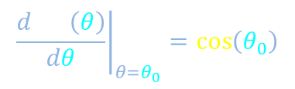
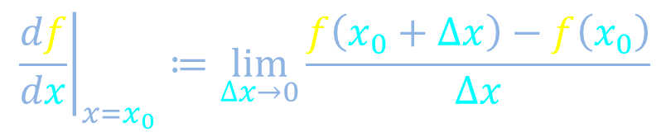


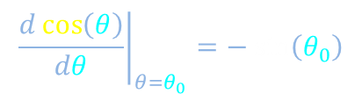
Differentiation
Derivatives and differentials
$${\left.\frac{df}{dx}\right|}_{x=x_{0}}≔\lim_{∆x→0}{\frac{f\left(x_{0}+∆x\right)−f\left(x_{0}\right)}{∆x}}$$
$$∆f$$
$$∆x$$
Products and
quotients
Power rule
Chain rule
Sinusoidal functions
$${\left.\frac{dx^{n}}{dx}\right|}_{x=x_{0}}=n{x_{0}}^{n−1}$$
$${\left.\frac{d\sin\left(θ\right)}{dθ}\right|}_{θ=θ_{0}}=\cos\left(θ_{0}\right)$$
$${\left.\frac{d\cos\left(θ\right)}{dθ}\right|}_{θ=θ_{0}}=−\sin\left(θ_{0}\right)$$

Slide 2
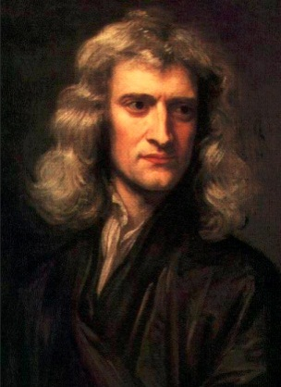
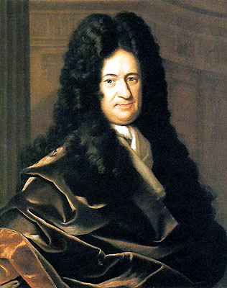


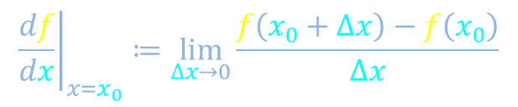



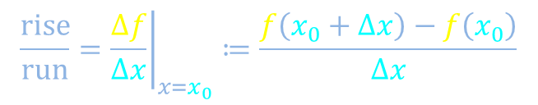



Slope and derivative
$$f\left(x\right)$$
$$f\left(x_{0}+∆x\right)$$
$$\frac{rise}{run}={\left.\frac{Δf}{Δx}\right|}_{x=x_{0}}≔\frac{f\left(x_{0}+∆x\right)−f\left(x_{0}\right)}{∆x}$$
$$∆f$$
$${\left.\frac{df}{dx}\right|}_{x=x_{0}}≔\lim_{∆x→0}{\frac{f\left(x_{0}+∆x\right)−f\left(x_{0}\right)}{∆x}}$$
$$f\left(x_{0}\right)$$
$$∆x$$
$$x$$
0
$$x_{0}$$
$$x_{0}+∆x$$

Slide 3


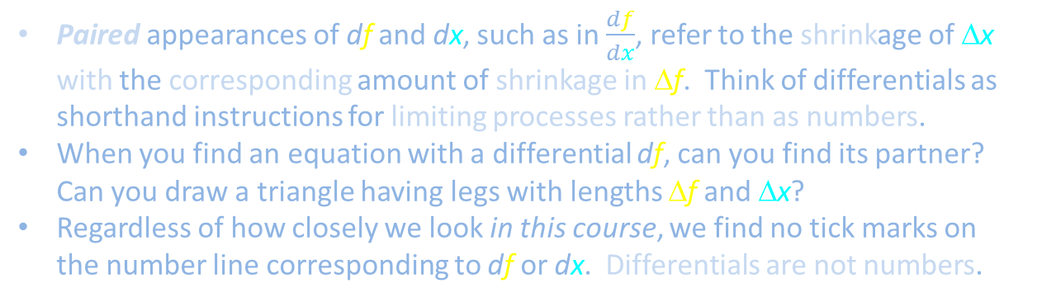


Differentials are not numbers
+5
$$\int{stuff df}$$
+4
$$\frac{df}{dx}$$
+3
+2
+1
$$∆f$$
0
#
-1
-2
$$∆x$$
-3
Paired appearances of df and dx, such as in $\frac{df}{dx}$, refer to the shrinkage of Δx with the corresponding amount of shrinkage in Δf. Think of differentials as shorthand instructions for limiting processes rather than as numbers.
When you find an equation with a differential df, can you find its partner? Can you draw a triangle having legs with lengths Δf and Δx?
Regardless of how closely we look in this course, we find no tick marks on the number line corresponding to df or dx. Differentials are not numbers.
-4
-5

Slide 4
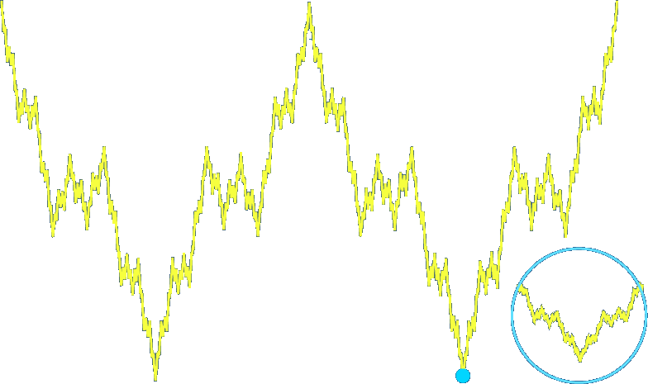


Weierstrass function
$$f\left(x\right)$$
$$x$$
0

Slide 5
Differentiation
Derivatives and differentials
$${\left.\frac{df}{dx}\right|}_{x=x_{0}}≔\lim_{∆x→0}{\frac{f\left(x_{0}+∆x\right)−f\left(x_{0}\right)}{∆x}}$$
$$∆f$$
$$∆x$$
Products and
quotients
Power rule
Chain rule
Sinusoidal functions
$${\left.\frac{dx^{n}}{dx}\right|}_{x=x_{0}}=n{x_{0}}^{n−1}$$
$${\left.\frac{d\sin\left(θ\right)}{dθ}\right|}_{θ=θ_{0}}=\cos\left(θ_{0}\right)$$
$${\left.\frac{d\cos\left(θ\right)}{dθ}\right|}_{θ=θ_{0}}=−\sin\left(θ_{0}\right)$$

Slide 6
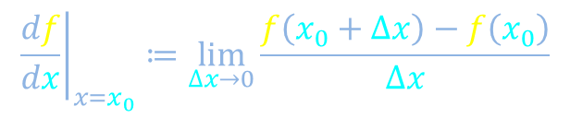

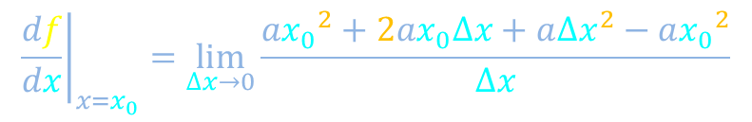

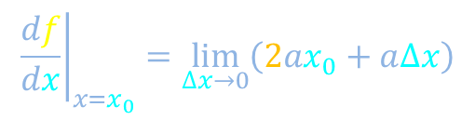

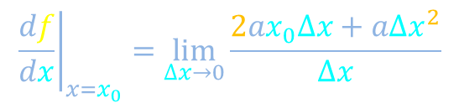



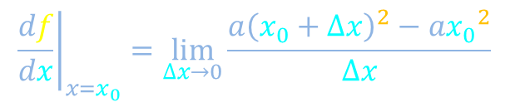
Derivative of a quadratic function
$${\left.\frac{df}{dx}\right|}_{x=x_{0}}≔\lim_{∆x→0}{\frac{f\left(x_{0}+∆x\right)−f\left(x_{0}\right)}{∆x}}$$
$$f\left(x\right)$$
$$f\left(x\right)=ax^{2}$$
$${\left.\frac{df}{dx}\right|}_{x=x_{0}}=\lim_{∆x→0}{\frac{a{\left(x_{0}+∆x\right)}^{2}−a{x_{0}}^{2}}{∆x}}$$
$${\left.\frac{df}{dx}\right|}_{x=x_{0}}=\lim_{∆x→0}{\frac{a{x_{0}}^{2}+2ax_{0}∆x+a{∆x}^{2}−a{x_{0}}^{2}}{∆x}}$$
$${\left.\frac{df}{dx}\right|}_{x=x_{0}}=\lim_{∆x→0}{\frac{2ax_{0}∆x+a{∆x}^{2}}{∆x}}$$
$$x$$
0
$${\left.\frac{df}{dx}\right|}_{x=x_{0}}=\lim_{∆x→0}\left(2ax_{0}+a∆x\right)$$
$$x_{0}$$
$$x_{0}+∆x$$
$${\left.\frac{df}{dx}\right|}_{x=x_{0}}=2ax_{0}$$

Slide 7
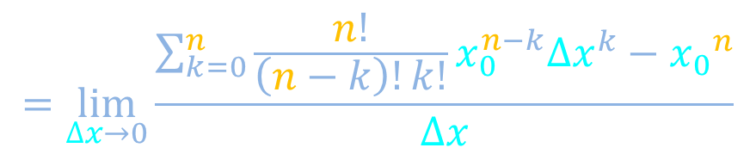



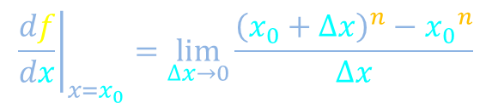
Derivative of power law
$${\left.\frac{df}{dx}\right|}_{x=x_{0}}≔\lim_{∆x→0}{\frac{f\left(x_{0}+∆x\right)−f\left(x_{0}\right)}{∆x}}$$
$$f\left(x\right)$$
$$f\left(x\right)=x^{n}$$
$${\left.\frac{df}{dx}\right|}_{x=x_{0}}=\lim_{∆x→0}{\frac{{\left(x_{0}+∆x\right)}^{n}−{x_{0}}^{n}}{∆x}}$$
$$=\lim_{∆x→0}{\frac{\sum_{k=0}^{n}{\frac{n!}{\left(n−k\right)!k!}x_{0}^{n−k}{∆x}^{k}}−{x_{0}}^{n}}{∆x}}$$
$$x$$
0
$$x_{0}$$
$$x_{0}+∆x$$
$${\left.\frac{df}{dx}\right|}_{x=x_{0}}=n{x_{0}}^{n−1}$$

Slide 8
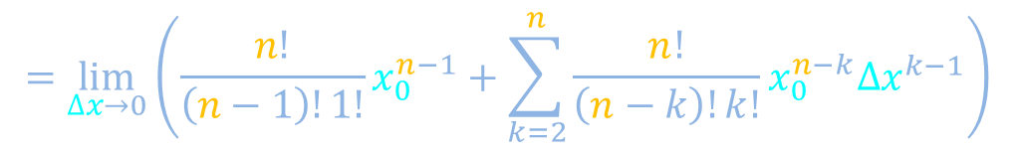

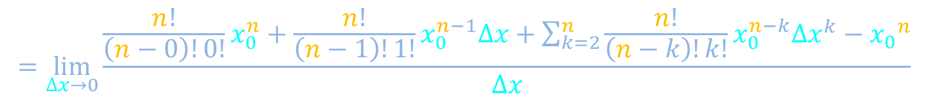




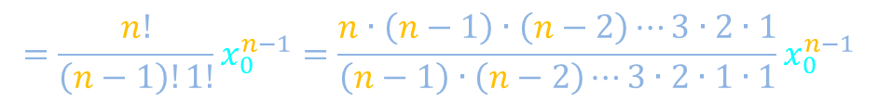
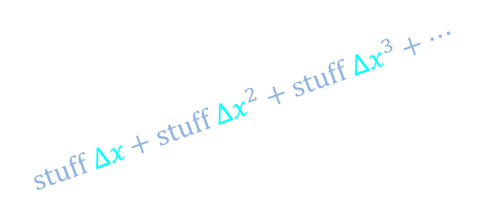
Derivative of power law
$$f\left(x\right)$$
$${\left.\frac{df}{dx}\right|}_{x=x_{0}}≔\lim_{∆x→0}{\frac{f\left(x_{0}+∆x\right)−f\left(x_{0}\right)}{∆x}}$$
$$f\left(x\right)=x^{n}$$
$$=\lim_{∆x→0}{\frac{\sum_{k=0}^{n}{\frac{n!}{\left(n−k\right)!k!}x_{0}^{n−k}{∆x}^{k}}−{x_{0}}^{n}}{∆x}}$$
$$x$$
0
$$x_{0}$$
$$x_{0}+∆x$$
$$=\lim_{∆x→0}{\frac{\frac{n!}{\left(n−0\right)!0!}x_{0}^{n}+\frac{n!}{\left(n−1\right)!1!}x_{0}^{n−1}∆x+\sum_{k=2}^{n}{\frac{n!}{\left(n−k\right)!k!}x_{0}^{n−k}{∆x}^{k}}−{x_{0}}^{n}}{∆x}}$$
$$=\lim_{∆x→0}\left(\frac{n!}{\left(n−1\right)!1!}x_{0}^{n−1}+\sum_{k=2}^{n}{\frac{n!}{\left(n−k\right)!k!}x_{0}^{n−k}{∆x}^{k−1}}\right)$$
$$stuff ∆x+stuff {∆x}^{2}+stuff {∆x}^{3}+⋯$$
$${\left.\frac{df}{dx}\right|}_{x=x_{0}}=n{x_{0}}^{n−1}$$
$$=\frac{n!}{\left(n−1\right)!1!}x_{0}^{n−1}=\frac{n∙\left(n−1\right)∙\left(n−2\right)⋯3∙2∙1}{\left(n−1\right)∙\left(n−2\right)⋯3∙2∙1∙1}x_{0}^{n−1}$$

Slide 9
Differentiation
Derivatives and differentials
$${\left.\frac{df}{dx}\right|}_{x=x_{0}}≔\lim_{∆x→0}{\frac{f\left(x_{0}+∆x\right)−f\left(x_{0}\right)}{∆x}}$$
$$∆f$$
$$∆x$$
Products and
quotients
Power rule
Chain rule
Sinusoidal functions
$${\left.\frac{dx^{n}}{dx}\right|}_{x=x_{0}}=n{x_{0}}^{n−1}$$
$${\left.\frac{d\sin\left(θ\right)}{dθ}\right|}_{θ=θ_{0}}=\cos\left(θ_{0}\right)$$
$${\left.\frac{d\cos\left(θ\right)}{dθ}\right|}_{θ=θ_{0}}=−\sin\left(θ_{0}\right)$$

Slide 10


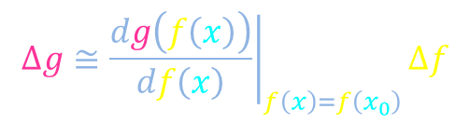





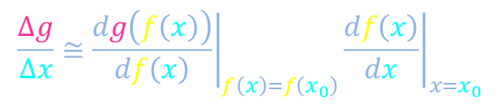




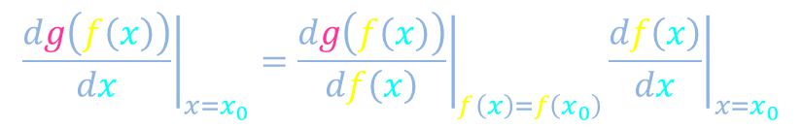
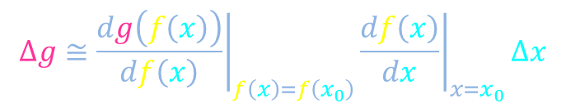


Chain rule
$${\left.\frac{df}{dx}\right|}_{x=x_{0}}≔\lim_{∆x→0}{\frac{f\left(x_{0}+∆x\right)−f\left(x_{0}\right)}{∆x}}$$
$$y=f\left(x\right)$$
$$f\left(x\right)$$
$$g\left(y\right)$$
$${\left.\frac{dg\left(f\left(x\right)\right)}{dx}\right|}_{x=x_{0}}={\left.\frac{dg\left(f\left(x\right)\right)}{df\left(x\right)}\right|}_{f\left(x\right)=f\left(x_{0}\right)}{\left.\frac{df\left(x\right)}{dx}\right|}_{x=x_{0}}$$
$$∆f$$
$$∆f≅{\left.\frac{df\left(x\right)}{dx}\right|}_{x=x_{0}}∆x$$
$$∆g$$
$$∆x$$
$$∆f$$
$$x$$
$$∆g≅{\left.\frac{dg\left(f\left(x\right)\right)}{df\left(x\right)}\right|}_{f\left(x\right)=f\left(x_{0}\right)}∆f$$
0
$$z=g(y)$$
$$∆g≅{\left.\frac{dg\left(f\left(x\right)\right)}{df\left(x\right)}\right|}_{f\left(x\right)=f\left(x_{0}\right)}{\left.\frac{df\left(x\right)}{dx}\right|}_{x=x_{0}}∆x$$
$$∆x$$
$$∆g$$
$$g\left(f\left(x\right)\right)$$
$$\frac{∆g}{∆x}≅{\left.\frac{dg\left(f\left(x\right)\right)}{df\left(x\right)}\right|}_{f\left(x\right)=f\left(x_{0}\right)}{\left.\frac{df\left(x\right)}{dx}\right|}_{x=x_{0}}$$

Slide 11
Differentiation
Derivatives and differentials
$${\left.\frac{df}{dx}\right|}_{x=x_{0}}≔\lim_{∆x→0}{\frac{f\left(x_{0}+∆x\right)−f\left(x_{0}\right)}{∆x}}$$
$$∆f$$
$$∆x$$
Products and
quotients
Power rule
Chain rule
Sinusoidal functions
$${\left.\frac{dx^{n}}{dx}\right|}_{x=x_{0}}=n{x_{0}}^{n−1}$$
$${\left.\frac{d\sin\left(θ\right)}{dθ}\right|}_{θ=θ_{0}}=\cos\left(θ_{0}\right)$$
$${\left.\frac{d\cos\left(θ\right)}{dθ}\right|}_{θ=θ_{0}}=−\sin\left(θ_{0}\right)$$

Slide 12

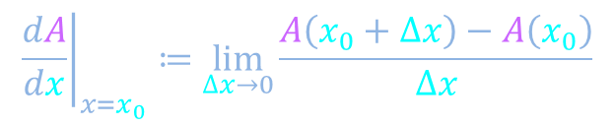










Product rule
$$A\left(x\right)=f\left(x\right)g\left(x\right)$$
$${\left.\frac{dA}{dx}\right|}_{x=x_{0}}≔\lim_{∆x→0}{\frac{A\left(x_{0}+∆x\right)−A\left(x_{0}\right)}{∆x}}$$
$$∆A=A\left(x_{0}+∆x\right)−A\left(x_{0}\right)$$
$$g\left(x\right)$$
$$g\left(x_{0}+∆x\right)$$
$$g\left(x_{0}\right)$$
0
$$f\left(x\right)$$
$$x_{0}$$
$$x_{0}+∆x$$
$$f\left(x_{0}\right)$$
$$x$$
$$f\left(x_{0}+∆x\right)$$

Slide 13





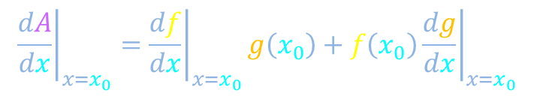

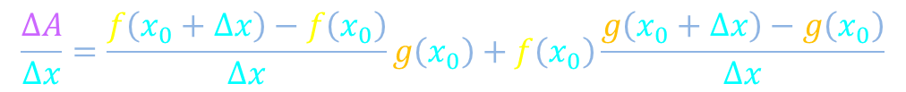
Product rule
$$A\left(x\right)=f\left(x\right)g\left(x\right)$$
$${\left.\frac{dA}{dx}\right|}_{x=x_{0}}≔\lim_{∆x→0}{\frac{A\left(x_{0}+∆x\right)−A\left(x_{0}\right)}{∆x}}$$
$$∆A=A\left(x_{0}+∆x\right)−A\left(x_{0}\right)$$
$$\frac{ΔA}{Δx}=\frac{f\left(x_{0}+∆x\right)−f\left(x_{0}\right)}{∆x}g\left(x_{0}\right)+f\left(x_{0}\right)\frac{g\left(x_{0}+∆x\right)−g\left(x_{0}\right)}{∆x}$$
$$fg$$
$${\left.\frac{dA}{dx}\right|}_{x=x_{0}}={\left.\frac{df}{dx}\right|}_{x=x_{0}}g\left(x_{0}\right)+f\left(x_{0}\right){\left.\frac{dg}{dx}\right|}_{x=x_{0}}$$
$$g\left(x\right)$$
$$g\left(x_{0}+∆x\right)$$
$$g\left(x_{0}\right)$$
$$x_{0}$$
0
$$f\left(x\right)$$
$$f\left(x_{0}\right)$$
$$x_{0}+∆x$$
$$f\left(x_{0}+∆x\right)$$
$$x$$

Slide 14

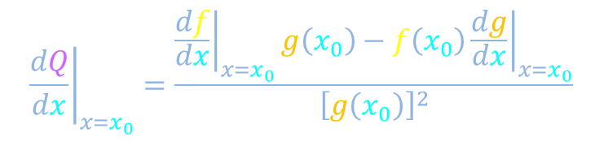
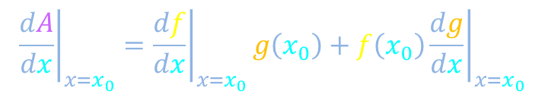
Quotient rule
$$A\left(x\right)=f\left(x\right)g\left(x\right)$$
$${\left.\frac{dA}{dx}\right|}_{x=x_{0}}≔\lim_{∆x→0}{\frac{A\left(x_{0}+∆x\right)−A\left(x_{0}\right)}{∆x}}$$
$${\left.\frac{dA}{dx}\right|}_{x=x_{0}}={\left.\frac{df}{dx}\right|}_{x=x_{0}}g\left(x_{0}\right)+f\left(x_{0}\right){\left.\frac{dg}{dx}\right|}_{x=x_{0}}$$
$$Q\left(x\right)=\frac{f\left(x\right)}{g\left(x\right)}$$
For the quotient
, what is the derivative?
STOP
$${\left.\frac{dQ}{dx}\right|}_{x=x_{0}}=\frac{{\left.\frac{df}{dx}\right|}_{x=x_{0}}g\left(x_{0}\right)−f\left(x_{0}\right){\left.\frac{dg}{dx}\right|}_{x=x_{0}}}{{\left[g\left(x_{0}\right)\right]}^{2}}$$
Why?

Slide 15
Differentiation
Derivatives and differentials
$${\left.\frac{df}{dx}\right|}_{x=x_{0}}≔\lim_{∆x→0}{\frac{f\left(x_{0}+∆x\right)−f\left(x_{0}\right)}{∆x}}$$
$$∆f$$
$$∆x$$
Products and
quotients
Power rule
Chain rule
Sinusoidal functions
$${\left.\frac{dx^{n}}{dx}\right|}_{x=x_{0}}=n{x_{0}}^{n−1}$$
$${\left.\frac{d\sin\left(θ\right)}{dθ}\right|}_{θ=θ_{0}}=\cos\left(θ_{0}\right)$$
$${\left.\frac{d\cos\left(θ\right)}{dθ}\right|}_{θ=θ_{0}}=−\sin\left(θ_{0}\right)$$

Slide 16
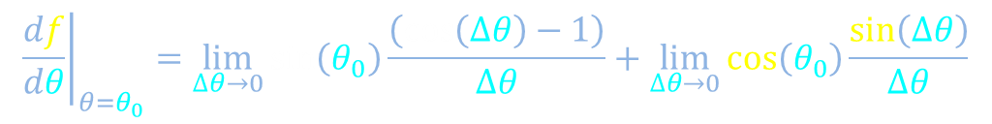

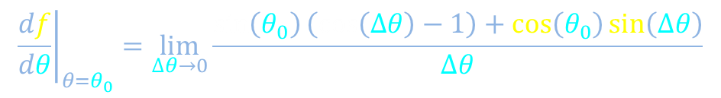
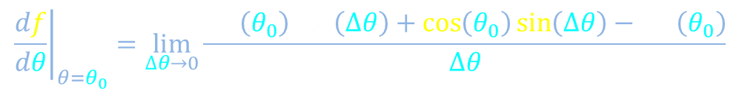
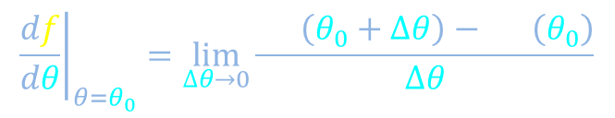
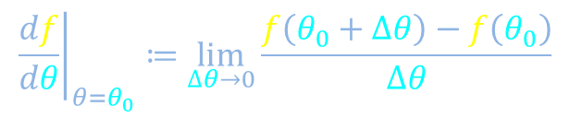
Derivative of sine
$${\left.\frac{df}{dθ}\right|}_{θ=θ_{0}}≔\lim_{∆θ→0}{\frac{f\left(θ_{0}+∆θ\right)−f\left(θ_{0}\right)}{∆θ}}$$
$$f\left(θ\right)=\sin\left(θ\right)$$
$${\left.\frac{df}{dθ}\right|}_{θ=θ_{0}}=\lim_{∆θ→0}{\frac{\sin\left(θ_{0}+∆θ\right)−\sin\left(θ_{0}\right)}{∆θ}}$$
Recall angle-addition identity from video on trigonometry
$${\left.\frac{df}{dθ}\right|}_{θ=θ_{0}}=\lim_{∆θ→0}{\frac{\sin\left(θ_{0}\right)\cos\left(∆θ\right)+\cos\left(θ_{0}\right)\sin\left(∆θ\right)−\sin\left(θ_{0}\right)}{∆θ}}$$
$${\left.\frac{df}{dθ}\right|}_{θ=θ_{0}}=\lim_{∆θ→0}{\frac{\sin\left(θ_{0}\right)\left(\cos\left(∆θ\right)−1\right)+\cos\left(θ_{0}\right)\sin\left(∆θ\right)}{∆θ}}$$
$${\left.\frac{df}{dθ}\right|}_{θ=θ_{0}}=\lim_{∆θ→0}{\sin\left(θ_{0}\right)\frac{\left(\cos\left(∆θ\right)−1\right)}{∆θ}}+\lim_{∆θ→0}{\cos\left(θ_{0}\right)\frac{\sin\left(∆θ\right)}{∆θ}}$$

Slide 17

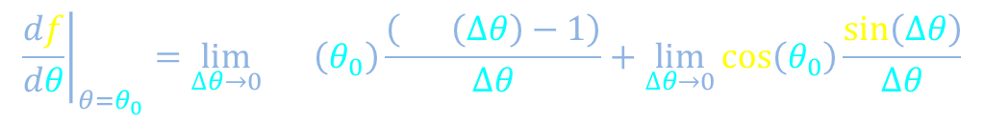





Derivative of sine
$${\left.\frac{df}{dθ}\right|}_{θ=θ_{0}}≔\lim_{∆θ→0}{\frac{f\left(θ_{0}+∆θ\right)−f\left(θ_{0}\right)}{∆θ}}$$
$$f\left(θ\right)=\sin\left(θ\right)$$
$${\left.\frac{df}{dθ}\right|}_{θ=θ_{0}}=\lim_{∆θ→0}{\sin\left(θ_{0}\right)\frac{\left(\cos\left(∆θ\right)−1\right)}{∆θ}}+\lim_{∆θ→0}{\cos\left(θ_{0}\right)\frac{\sin\left(∆θ\right)}{∆θ}}$$
$${\left.\frac{df}{dθ}\right|}_{θ=θ_{0}}=\cos\left(θ_{0}\right)$$
0
1
1
$$∆θ$$
$$\sin\left(∆θ\right)$$
$$∆θ$$
$$\cos\left(∆θ\right)$$
$$1−\cos\left(∆θ\right)$$

Slide 18

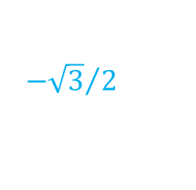





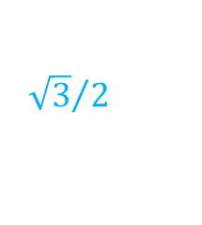





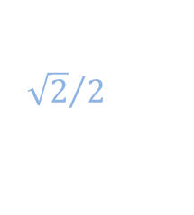




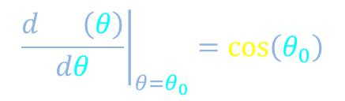







Trigonometry: sine and cosine
$${\left.\frac{d\sin\left(θ\right)}{dθ}\right|}_{θ=θ_{0}}=\cos\left(θ_{0}\right)$$
1
$$\sin\left(θ\right)$$
$${\sqrt{3}}/2$$
$${\sqrt{2}}/2$$
$$1/2$$
$$\cos\left(θ\right)$$
$$θ$$
0
$$\frac{2π}{3}$$
$$\frac{3π}{4}$$
$$\frac{5π}{6}$$
$$\frac{5π}{4}$$
$$\frac{3π}{2}$$
$$\frac{5π}{3}$$
$$\frac{11π}{6}$$
$$\frac{π}{6}$$
$$\frac{π}{4}$$
$$\frac{π}{3}$$
$$\frac{π}{2}$$
$$π$$
$$\frac{7π}{6}$$
$$\frac{4π}{3}$$
$$\frac{7π}{4}$$
$$2π$$
$$−1/2$$
$${−\sqrt{2}}/2$$
$${−\sqrt{3}}/2$$
-1

Slide 19





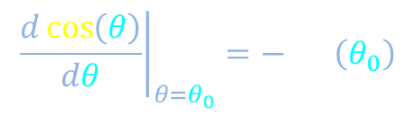
Derivative of cosine
$${\left.\frac{d\sin\left(θ\right)}{dθ}\right|}_{θ=θ_{0}}=\cos\left(θ_{0}\right)$$
$${\left.\frac{d\cos\left(θ\right)}{dθ}\right|}_{θ=θ_{0}}=−\sin\left(θ_{0}\right)$$
Hint:
STOP
$$\frac{π}{2}−θ$$
$$\sin\left(θ\right)=\cos\left(\frac{π}{2}−θ\right)$$
$$θ$$
$$\cos\left(θ\right)=\sin\left(\frac{π}{2}−θ\right)$$

Slide 20
Differentiation
Derivatives and differentials
$${\left.\frac{df}{dx}\right|}_{x=x_{0}}≔\lim_{∆x→0}{\frac{f\left(x_{0}+∆x\right)−f\left(x_{0}\right)}{∆x}}$$
$$∆f$$
$$∆x$$
Products and
quotients
Power rule
Chain rule
Sinusoidal functions
$${\left.\frac{dx^{n}}{dx}\right|}_{x=x_{0}}=n{x_{0}}^{n−1}$$
$${\left.\frac{d\sin\left(θ\right)}{dθ}\right|}_{θ=θ_{0}}=\cos\left(θ_{0}\right)$$
$${\left.\frac{d\cos\left(θ\right)}{dθ}\right|}_{θ=θ_{0}}=−\sin\left(θ_{0}\right)$$

